Slide 1
Audisankara institute of technology COMMUNITY INTERSHIP PROJECT BAN PLASTICS
Submited By…
RAJA GOKULAKRISHNAN Mrs.G SWATHI
Assoc Professor CSE
212H1A3055
ARTIFICIAL INTELLIGENCE & DATA SCIENCE

Slide 2
ABSTRACT FOR BAN PLASTICS…
The adverse environmental impacts of plastic pollution have become a global concern, necessitating urgent and collaborative efforts at the community level.
"Project Green Horizon" aims to address this critical issue by implementing a comprehensive strategy to ban plastics within our community.
The project involves a multifaceted approach encompassing awareness campaigns, alternative solutions, policy advocacy, and community engagement.
Raise awareness, promote alternatives, community engangement, policy advocacy, monitoring and evaluation.

Slide 3
INTRODUCTION…
In the wake of accelerating environmental degradation, one of the most pervasive and urgent challenges confronting communities worldwide is the ubiquitous presence of plastic pollution.
From clogging our waterways to infiltrating our soil and harming wildlife, the detrimental effects of single-use plastics have reached an alarming magnitude.
In response to this crisis, the imperative to ban plastics has emerged not only as a moral duty but as an essential stride toward safeguarding our planet's ecological balance,
As we embark on this endeavor to ban plastics, we acknowledge the challenges ahead and the need for a multifaceted approach

Slide 4
PROBLEMS IDENTIFIED IN COMMUNITY…
Identifying problems associated with banning plastics requires a comprehensive understanding of the various challenges.
That may arise during the transition. Here are some key issues commonly associated with the initiative to ban plastics.
I mostly identified in Gudur district but not only here in every state can facing this problems against plastics.
Resistance from individuals and businesses may arise due to a lack of awareness regarding the environmental impact of plastics or alternative solutions.
Consumers may resist the ban due to concerns about convenience, habit, or perceived inconvenience of alternatives.

Slide 5
SOLUTION PROVIDED IN EACH WEEK…
Encourage the development and availability of sustainable alternatives, support innovation in packaging and materials, and collaborate with businesses to promote and adopt eco-friendly options.
Collaborate with international stakeholders, industry associations, and regulatory bodies to establish global standards and encourage responsible sourcing and production.
Promote the ease and convenience of eco-friendly alternatives, conduct educational campaigns to shift consumer behavior, and collaborate with businesses to make sustainable options more accessible

Slide 6
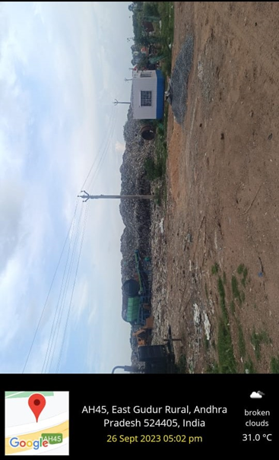
IMAGE & SOLUTION…
→Conduct thorough environmental impact assessments, promote the use of truly sustainable alternatives, and continuously monitor and adapt policies based on new information.
→Identifying and addressing these challenges proactively is essential for the successful implementation of plastic bans, ensuring a more sustainable and effective transition away from single-use plastics.
→The only way to stay free from plastics pollution and other environmental causes to avoid usages of plastics.
→Each and every person take serious on a society to avoid usage of plastics.

Slide 7
CONCLUSION…
In the pursuit of banning plastics, we stand at the forefront of a pivotal movement that transcends individual actions to embody a collective commitment to environmental stewardship.
The imperative to eliminate single-use plastics is not merely a response to an ecological crisis but a transformative journey towards redefining our relationship with the planet we call home.
As we reflect on the challenges and opportunities presented by this endeavor, it is evident that the journey to ban plastics is a multifaceted one, requiring a harmonious blend of innovation, education, and policy.
The future promises a landscape where technological advancements, sustainable alternatives, and circular economy principles converge to usher in a new era of responsible consumption and production.

Slide 8
FUTURE ENHANCEMENT…
Enhancing and sustaining efforts to ban plastics involves continuous improvement, innovation, and adaptation to emerging challenges.
Here are potential future enhancements to strengthen and extend the impact of plastic ban initiatives.
Technological Innovation:Support research and development in materials science to create innovative packaging solutions with minimal environmental impact.
Cross-Sector Collaboration:Engage in multi-stakeholder partnerships to address challenges comprehensively and holistically.
Global Collaboration and Standards:Advocate for international collaboration to establish global standards for sustainable packaging materials and practices.

Slide 9
THANKING YOU…
DESIGNED BY…
RAJA GOKULAKRISHNAN
212H1A3055
AI/DS – ‘A’

